Slide 1
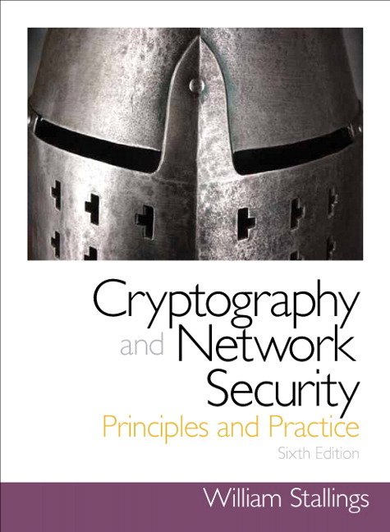
Cryptography and Network Security
Sixth Edition
by William Stallings
Notes:
Lecture slides prepared for “Cryptography and Network Security”, 6/e, by William Stallings. Chapter 1, “Overview”.

Slide 2
Chapter 7
Public Key Cryptography

Slide 3
Types of Ciphers
Cryptography
Classical
Modern (Key-based)
Symmetric
Asymmetric
Hash Function
Block
Stream
RSA
Diffie-Hellman
MD5
SHA
DES
AES
RC4

Slide 4

Public-Key encryption structure
First publicly proposed by Diffie and Hellman in 1976
Based on mathematical functions rather than on simple operations on bit patterns
Is asymmetric, involving the use of two separate keys
Misconceptions:
Public-key encryption is more secure from cryptanalysis than conventional encryption
Public-key encryption is a general-purpose technique that has made conventional encryption obsolete
There is a feeling that key distribution is trivial when using public-key encryption, compared to the rather cumbersome handshaking involved with key distribution centers for conventional encryption
Notes:
Public-key encryption, first publicly proposed by Diffie and Hellman in 1976
[DIFF76], is the first truly revolutionary advance in encryption in literally thousands
of years. Public-key algorithms are based on mathematical functions rather
than on simple operations on bit patterns, such as are used in symmetric encryption
algorithms. More important, public-key cryptography is asymmetric, involving the
use of two separate keys—in contrast to the symmetric conventional encryption,
which uses only one key. The use of two keys has profound consequences in the
areas of confidentiality, key distribution, and authentication.
Before proceeding, we should first mention several common misconceptions
concerning public-key encryption. One is that public-key encryption is more
secure from cryptanalysis than conventional encryption. In fact, the security of any
encryption scheme depends on (1) the length of the key and (2) the computational
work involved in breaking a cipher. There is nothing in principle about either conventional
or public-key encryption that makes one superior to another from the
point of view of resisting cryptanalysis. A second misconception is that public-key
encryption is a general-purpose technique that has made conventional encryption
obsolete. On the contrary, because of the computational overhead of current public-
key encryption schemes, there seems no foreseeable likelihood that conventional
encryption will be abandoned. Finally, there is a feeling that key distribution
is trivial when using public-key encryption, compared to the rather cumbersome
handshaking involved with key distribution centers for conventional encryption.
In fact, some form of protocol is needed, often involving a central agent, and the
procedures involved are no simpler or any more efficient than those required for
conventional encryption.

Slide 5
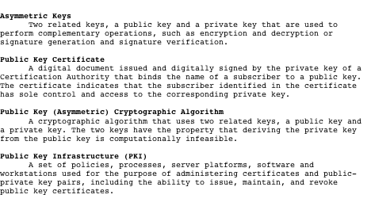
Terminology Related to Asymmetric Encryption
Notes:
Table 9.1 defines some key terms.

Slide 6
Public Key Certificate

Slide 7
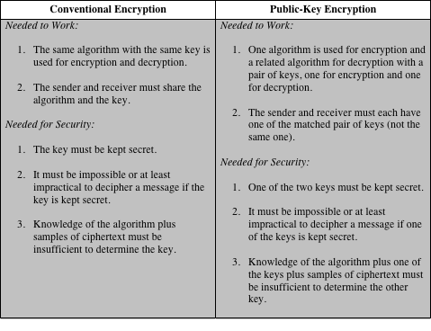
Conventional and Public-Key Encryption
Notes:
Table 9.2 summarizes some of the important aspects of symmetric and public-key
encryption. To discriminate between the two, we refer to the key used in symmetric
encryption as a secret key . The two keys used for asymmetric encryption are
referred to as the public key and the private key . Invariably, the private key is kept
secret, but it is referred to as a private key rather than a secret key to avoid confusion
with symmetric encryption.

Slide 8
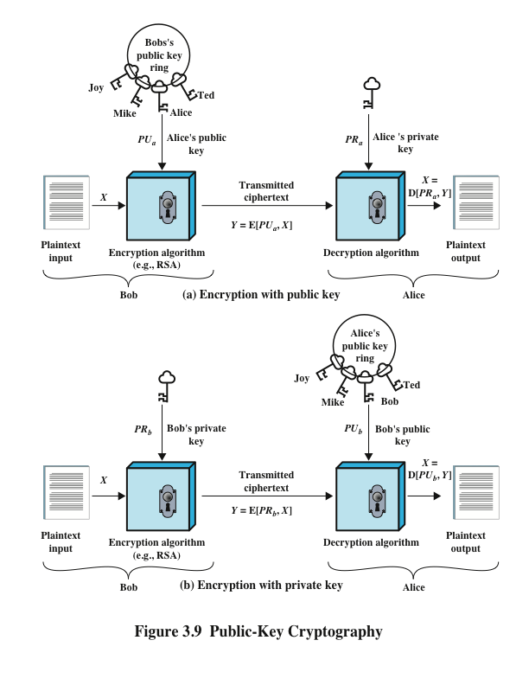

Slide 9
Applications for Public-Key Cryptosystems
Public-key cryptosystems can be classified into three categories:
Some algorithms are suitable for all three applications, whereas others can be used only for one or two.
Encryption/decryption
The sender encrypts a message with the recipient’s public key
Digital signature
The sender “signs” a message with its private key
Key exchange
Two sides cooperate to exchange a session key
Notes:
Before proceeding, we need to clarify one aspect of public-key cryptosystems that is
otherwise likely to lead to confusion. Public-key systems are characterized by the use
of a cryptographic algorithm with two keys, one held private and one available publicly.
Depending on the application, the sender uses either the sender’s private key or
the receiver’s public key, or both, to perform some type of cryptographic function. In
broad terms, we can classify the use of public-key cryptosystems into three categories
• Encryption/decryption: The sender encrypts a message with the recipient’s
public key.
• Digital signature: The sender “signs” a message with its private key. Signing
is achieved by a cryptographic algorithm applied to the message or to a small
block of data that is a function of the message.
• Key exchange: Two sides cooperate to exchange a session key. Several different
approaches are possible, involving the private key(s) of one or both parties.

Slide 10
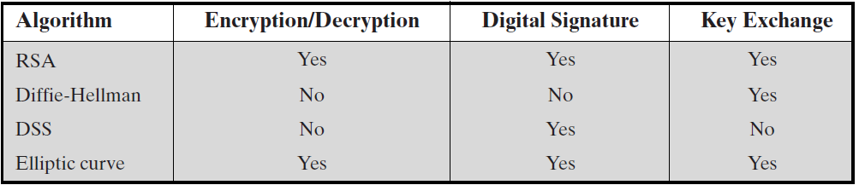
Table 3.2 applications for public-key cryptosystems
Notes:
Some algorithms are suitable for all three applications, whereas others can be
used only for one or two of these applications. Table 9.3 indicates the applications
supported by the algorithms discussed in this book.

Slide 11
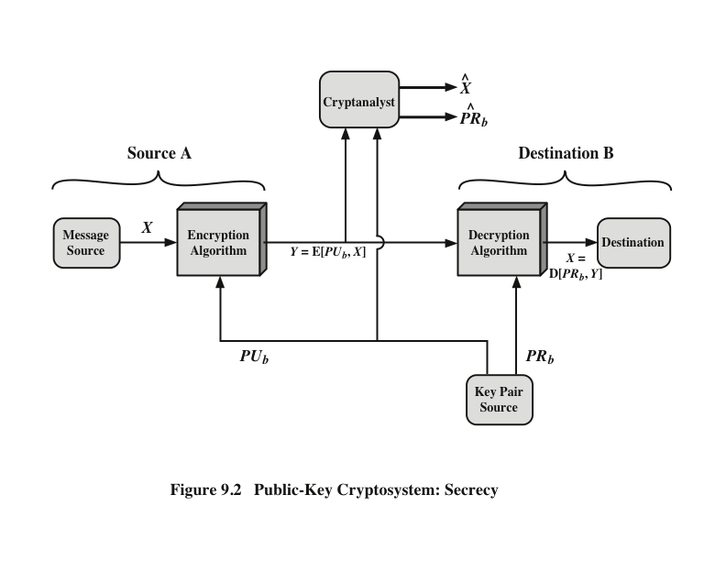
Public-Key Cryptosystem: Secrecy

Slide 12
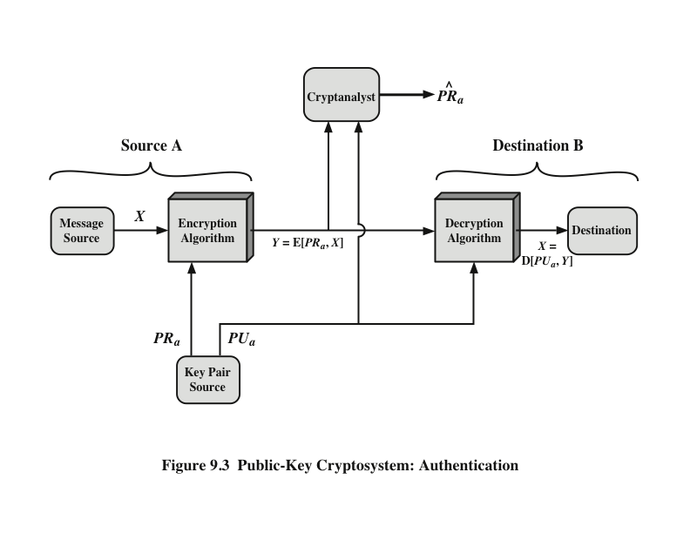
Public-Key Cryptosystem: Authentication

Slide 13
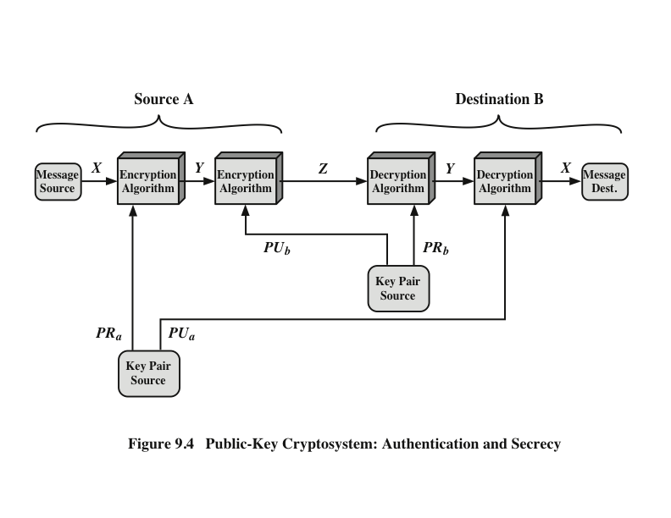
Public-Key Cryptosystem: Authentication & Secrecy
Notes:
The security of RSA depends on it being used in such a
way as to counter potential attacks. Four possible attack approaches are as follows:
■ Mathematical attacks: There are several approaches, all equivalent in effort to
factoring the product of two primes. The defense against mathematical attacks
is to use a large key size. Thus, the larger the number of bits in d , the better.
However, because the calculations involved, both in key generation and in encryption/
decryption, are complex, the larger the size of the key, the slower the
system will run. SP 800-131A (Transitions: Recommendation for Transitioning
the Use of Cryptographic Algorithms and Key Lengths , November 2015) recommends
the use of a 2048-bit key size. A recent report from the European
Union Agency for Network and Information Security (Algorithms, key size
and parameters report—2014 , November 2014) recommends a 3072-bit key
length. Either of these lengths should provide adequate security for a considerable
time into the future.
■ Timing attacks: These depend on the running time of the decryption algorithm.
Various approaches to mask the time required so as to thwart attempts
to deduce key size have been suggested, such as introducing a random delay.
■ Chosen ciphertext attacks: This type of attack exploits properties of the RSA
algorithm by selecting blocks of data that, when processed using the target’s
private key, yield information needed for cryptanalysis. These attacks can be
thwarted by suitable padding of the plaintext.
To counter sophisticated chosen ciphertext attacks, RSA Security Inc., a
leading RSA vendor and former holder of the RSA patent, recommends modifying
the plaintext using a procedure known as optimal asymmetric encryption padding
(OAEP). A full discussion of the threats and OAEP are beyond our scope;
see [POIN02] for an introduction and [BELL94a] for a thorough analysis. Here, we
simply summarize the OAEP procedure.

Slide 14
Public-Key Requirements
It must be computationally:
easy to generate a public / private key pair
hard to determine the private key given the public key
easy to encrypt using the public key
easy to decrypt using the private key
hard to recover the plaintext message from just the ciphertext and the public key
(optional) The two keys can be applied in either order:
M = D[PU_{b} , E(PR_{b}, M)] = D[PR_{b}, E(PU_{b}, M)]
Notes:
The cryptosystem illustrated in Figures 9.2 through 9.4 depends on a cryptographic algorithm based on two related keys. Diffie and Hellman postulated this system without demonstrating that such algorithms exist. However, they did lay out the conditions that such algorithms must fulfill:
It is computationally easy for a party B to generate a pair (public key PU_{b}, private key PR_{b}).
It is computationally easy for a sender A, knowing the public key and the message to be encrypted, M, to generate the corresponding ciphertext:
C = E(PU_{b}, M)
3. It is computationally easy for the receiver B to decrypt the resulting ciphertext using the private key to recover the original message: M = D(PR_{b}, C) = D[PR_{b}, E(PU_{b}, M)
4. It is computationally infeasible for an adversary, knowing the public key, PU_{b}, to determine the private key, PR_{b}
5. It is computationally infeasible for an adversary, knowing the public key, PU_{b}, and a ciphertext, C, to recover the original message, M.
6. (optional) The two keys can be applied in either order:
M = D[PU_{b} , E(PR_{b}, M)] = D[PR_{b}, E(PU_{b}, M)]
These are formidable requirements, as evidenced by the fact that only a few algorithms (RSA, elliptic curve cryptography, Diffie-Hellman, DSS) have received widespread acceptance in the several decades since the concept of public-key cryptography was proposed.

Slide 15
Public-Key Requirements
Need a trap-door one-way function
A one-way function is one that maps a domain into a range such that every function value has a unique inverse, with the condition that the calculation of the function is easy, whereas the calculation of the inverse is infeasible
Y = f(X) easy
X = f^{–1}(Y) infeasible
A trap-door one-way function is a family of invertible functions f_{k}, such that
Y = f_{k}(X) easy, if k and X are known
X = f_{k}^{–1}(Y) easy, if k and Y are known
X = f_{k}^{–1}(Y) infeasible, if Y known but k not known
A practical public-key scheme depends on a suitable trap-door one-way function
Notes:
Before elaborating on why the requirements are so formidable, let us first recast
them. The requirements boil down to the need for a trap-door one-way function.
A one-way function is one that maps a domain into a range such that every
function value has a unique inverse, with the condition that the calculation of the
function is easy, whereas the calculation of the inverse is infeasible
Y = f(X) easy
X = f^{–1}(Y) infeasible
Generally, easy is defined to mean a problem that can be solved in polynomial
time as a function of input length. Thus, if the length of the input is n bits, then the
time to compute the function is proportional to nª , where a is a fixed constant. Such
algorithms are said to belong to the class P . The term infeasible is a much fuzzier
concept. In general, we can say a problem is infeasible if the effort to solve it grows
faster than polynomial time as a function of input size. For example, if the length
of the input is n bits and the time to compute the function is proportional to 2^{n} ,
the problem is considered infeasible. Unfortunately, it is difficult to determine if a
particular algorithm exhibits this complexity. Furthermore, traditional notions of
computational complexity focus on the worst-case or average-case complexity of
an algorithm. These measures are inadequate for cryptography, which requires that
it be infeasible to invert a function for virtually all inputs, not for the worst case or
even average case. A brief introduction to some of these concepts is provided in
Appendix 9A.
We now turn to the definition of a trap-door one-way function , which is easy
to calculate in one direction and infeasible to calculate in the other direction unless
certain additional information is known. With the additional information the
inverse can be calculated in polynomial time. We can summarize as follows: A trapdoor
one-way function is a family of invertible functions f_{k} , such that
Y = f_{k}(X) easy, if k and X are known
X = f_{k}^{–1}(Y) easy, if k and Y are known
X = f_{k}^{–1}(Y) infeasible, if Y known but k not known
Thus, the development of a practical public-key scheme depends on discovery of a suitable trap-door one-way function.

Slide 16
Public-Key Cryptanalysis
A public-key encryption scheme is vulnerable to a brute-force attack
Countermeasure: use large keys
Key size must be small enough for practical encryption and decryption
The proposed key sizes result in encryption and decryption speeds that are too slow for general-purpose use
Public-key encryption is currently confined to key management and signature applications
Another form of attack is to find some way to compute the private key given the public key: To date, it has not been mathematically proven that this form of attack is infeasible for any particular public-key algorithm.
Finally, there is a probable-message attack: This attack can be avoided by appending some random bits to simple messages
Notes:
As with symmetric encryption, a public-key encryption scheme is vulnerable to a
brute-force attack. The countermeasure is the same: Use large keys. However, there
is a tradeoff to be considered. Public-key systems depend on the use of some sort of
invertible mathematical function. The complexity of calculating these functions may
not scale linearly with the number of bits in the key but grow more rapidly than that.
Thus, the key size must be large enough to make brute-force attack impractical but
small enough for practical encryption and decryption. In practice, the key sizes that
have been proposed do make brute-force attack impractical but result in encryption/
decryption speeds that are too slow for general-purpose use. Instead, as was mentioned
earlier, public-key encryption is currently confined to key management and
signature applications.
Another form of attack is to find some way to compute the private key given
the public key. To date, it has not been mathematically proven that this form of attack
is infeasible for a particular public-key algorithm. Thus, any given algorithm,
including the widely used RSA algorithm, is suspect. The history of cryptanalysis
shows that a problem that seems insoluble from one perspective can be found to
have a solution if looked at in an entirely different way.
Finally, there is a form of attack that is peculiar to public-key systems. This is,
in essence, a probable-message attack. Suppose, for example, that a message were to
be sent that consisted solely of a 56-bit DES key. An adversary could encrypt all possible
56-bit DES keys using the public key and could discover the encrypted key by
matching the transmitted ciphertext. Thus, no matter how large the key size of the
public-key scheme, the attack is reduced to a brute-force attack on a 56-bit key. This
attack can be thwarted by appending some random bits to such simple messages.

Slide 17
Rivest-Shamir-Adleman (RSA) Algorithm
Developed in 1977 at MIT by Ron Rivest, Adi Shamir & Len Adleman
Most widely used general-purpose approach to public-key encryption
Basis: factorization of large numbers is hard
A typical key length (1024 bits or greater)
Plaintext block size must be smaller than key size
Ciphertext block size is same as key size
Notes:
The pioneering paper by Diffie and Hellman [DIFF76b] introduced a new approach
to cryptography and, in effect, challenged cryptologists to come up with a cryptographic
algorithm that met the requirements for public-key systems. A number of
algorithms have been proposed for public-key cryptography. Some of these, though
initially promising, turned out to be breakable.
One of the first successful responses to the challenge was developed in 1977
by Ron Rivest, Adi Shamir, and Len Adleman at MIT and first published in 1978
[RIVE78]. The Rivest-Shamir-Adleman (RSA) scheme has since that time reigned
supreme as the most widely accepted and implemented general-purpose approach
to public-key encryption.
The RSA scheme is a cipher in which the plaintext and ciphertext are integers
between 0 and n - 1 for some n . A typical size for n is 1024 bits, or 309 decimal
digits. That is, n is less than 2¹⁰²⁴ . We examine RSA in this section in some detail,
beginning with an explanation of the algorithm. Then we examine some of the computational
and cryptanalytical implications of RSA.

Slide 18
RSA Algorithm
Encryption and decryption are of the following form, for some plaintext block M and ciphertext block C
C = Me mod n
M = C^{d} mod n = (Me)^{d} mod n = M^{ed} mod n
Both sender and receiver must know the value of n
The sender knows the value of e, and the public key PU={e,n}
The receiver knows the value of d, and the private key PR={d,n}
Notes:
RSA makes use of an expression with exponentials. Plaintext is encrypted in blocks,
with each block having a binary value less than some number n . That is, the block
size must be less than or equal to log₂ (n ) + 1; in practice, the block size is i bits,
where 2^{i} < n ≤ 2^{i+1} . Encryption and decryption are of the following form, for some
plaintext block M and ciphertext block C.
C = Me mod n
M = C^{d} mod n = (Me )^{d} mod n = M^{ed} mod n
Both sender and receiver must know the value of n . The sender knows the
value of e , and only the receiver knows the value of d . Thus, this is a public-key encryption
algorithm with a public key of PU = {e , n } and a private key of PR = {d , n }.

Slide 19
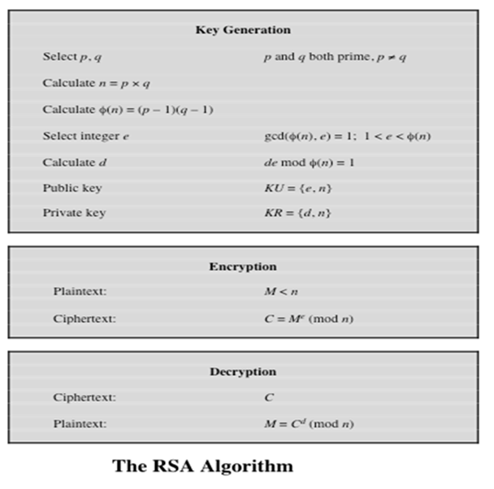
Notes:
The two most widely used public-key algorithms are RSA and Diffie–Hellman.
We look at both of these in this section and then briefly introduce two other
algorithms.
One of the first public-key schemes was developed in 1977 by Ron Rivest, Adi
Shamir, and Len Adleman at MIT and first published in 1978 [RIVE78]. The
RSA scheme has since that time reigned supreme as the most widely accepted and
implemented approach to public-key encryption. RSA is a block cipher in which the
plaintext and ciphertext are integers between 0 and n - 1 for some n.
Figure 3.10 summarizes the RSA algorithm.

Slide 20
How RSA work with example
Generate public and private key
1. Select two prime P & Q
P = 53, Q = 59
2. calculate first part of public key = n
N = P.Q
N= 53x59 = 3127
3. calculate φ(n)
φ(n) = (P-1)(Q-1)
φ(n) = (53-1)(59-1) = 3016

Slide 21
How RSA work with example
4. We also need a small exponent e, e must :
Be an integer
1<e< φ(n)
Not be a factor of n : gcd(φ(n),e)= 1
For example : e = 3.
So PU (public key) = {e,n}
PU = {3,3127}
5. Now Calculate PR( Private Key) = { d,n}
e.d mod φ(n)=1 which can be calculated as :
d = (s. φ(n)+1)/e (s={1,2,3,…})
d = (2x 3016+1)/3 = 2011
PR = {2011,3127}

Slide 22
How RSA work with example
Encrypt data with Public key
A simple Example : Lets encrypt “hi”
Convert letters to numbers: h = 7 & i =8 -> 78
C = Me mod n
C = 78³ mod 3127 = 2375
Decrypt data with private key
M = C^{d} mod n
M = 2375²⁰¹¹ mod 3127 → 78
7= H , 8 = I (start from zero).

Slide 23
RSA example 1
Select primes p=11, q=3
n=pxq=11x3=33
φ(n)=(p-1)x(q-1)=10x2=20
Choose e that is relatively prime with φ→e=3
Find the multiplicative inverse (d) such that e.d ≡ 1 mod 20 (0≤d≤n)→ d=7
PU={e,n}={3,33} PR={d,n}={7,33}

Slide 24
RSA example 1
Suppose message to encrypt is M=8
C=Me mod n= 8³ mod 33= 512 mod 33=17
Decryption:
M=C^{d} mod n= 17⁷ mod 33= 8

Slide 25
RSA example 2
Select primes: p=17 & q=11
Compute n=p.q=17x11=187
Compute φ(n)=(p-1)x(q-1)=16x10=160
Select e where gcd(e,160)=1→ e=7
Determine d= (s.φ(n)+1)/e= (1x160 +1)/7=23
Pub={7,187} PR={23,187}

Slide 26
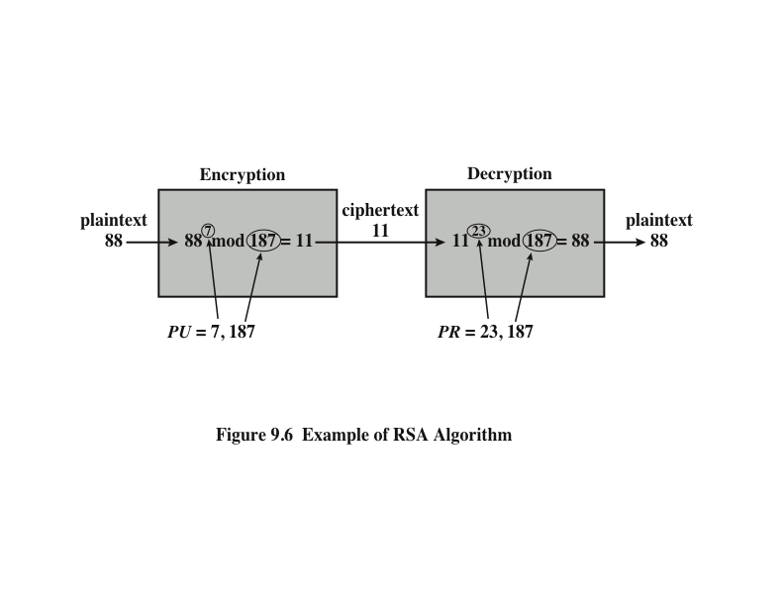
Example of RSA Algorithm
Given message M=88, Pub={7,187} , PR={23,187}
Notes:
An example from [SING99] is shown in Figure 9.6.

Slide 27
Security considerations
The security of RSA depends on it being used in such a way as to counter potential attacks
Possible attack approaches against RSA are:
Brute force attack: try all possible private keys – can be defeated by using a large enough key space (e.g., 1024 bit keys or larger)
Mathematical attack: factor n into the product of two primes (possible for special cases of n)
Notes:
The security of RSA depends on it being used in such a
way as to counter potential attacks. Four possible attack approaches are as follows:
■ Mathematical attacks: There are several approaches, all equivalent in effort to
factoring the product of two primes. The defense against mathematical attacks
is to use a large key size. Thus, the larger the number of bits in d , the better.
However, because the calculations involved, both in key generation and in encryption/
decryption, are complex, the larger the size of the key, the slower the
system will run. SP 800-131A (Transitions: Recommendation for Transitioning
the Use of Cryptographic Algorithms and Key Lengths , November 2015) recommends
the use of a 2048-bit key size. A recent report from the European
Union Agency for Network and Information Security (Algorithms, key size
and parameters report—2014 , November 2014) recommends a 3072-bit key
length. Either of these lengths should provide adequate security for a considerable
time into the future.
■ Timing attacks: These depend on the running time of the decryption algorithm.
Various approaches to mask the time required so as to thwart attempts
to deduce key size have been suggested, such as introducing a random delay.
■ Chosen ciphertext attacks: This type of attack exploits properties of the RSA
algorithm by selecting blocks of data that, when processed using the target’s
private key, yield information needed for cryptanalysis. These attacks can be
thwarted by suitable padding of the plaintext.
To counter sophisticated chosen ciphertext attacks, RSA Security Inc., a
leading RSA vendor and former holder of the RSA patent, recommends modifying
the plaintext using a procedure known as optimal asymmetric encryption padding
(OAEP). A full discussion of the threats and OAEP are beyond our scope;
see [POIN02] for an introduction and [BELL94a] for a thorough analysis. Here, we
simply summarize the OAEP procedure.

Slide 28
Security considerations
The security of RSA depends on it being used in such a way as to counter potential attacks
Possible attack approaches against RSA are:
Timing attack: recover the private key from the running time of the decryption algorithm.
can be defeated by adding a random delay
The attacker may be able to defeat random delay if the delay is not added carefully.
Hurt the performance.
Notes:
The security of RSA depends on it being used in such a
way as to counter potential attacks. Four possible attack approaches are as follows:
■ Mathematical attacks: There are several approaches, all equivalent in effort to
factoring the product of two primes. The defense against mathematical attacks
is to use a large key size. Thus, the larger the number of bits in d , the better.
However, because the calculations involved, both in key generation and in encryption/
decryption, are complex, the larger the size of the key, the slower the
system will run. SP 800-131A (Transitions: Recommendation for Transitioning
the Use of Cryptographic Algorithms and Key Lengths , November 2015) recommends
the use of a 2048-bit key size. A recent report from the European
Union Agency for Network and Information Security (Algorithms, key size
and parameters report—2014 , November 2014) recommends a 3072-bit key
length. Either of these lengths should provide adequate security for a considerable
time into the future.
■ Timing attacks: These depend on the running time of the decryption algorithm.
Various approaches to mask the time required so as to thwart attempts
to deduce key size have been suggested, such as introducing a random delay.
■ Chosen ciphertext attacks: This type of attack exploits properties of the RSA
algorithm by selecting blocks of data that, when processed using the target’s
private key, yield information needed for cryptanalysis. These attacks can be
thwarted by suitable padding of the plaintext.
To counter sophisticated chosen ciphertext attacks, RSA Security Inc., a
leading RSA vendor and former holder of the RSA patent, recommends modifying
the plaintext using a procedure known as optimal asymmetric encryption padding
(OAEP). A full discussion of the threats and OAEP are beyond our scope;
see [POIN02] for an introduction and [BELL94a] for a thorough analysis. Here, we
simply summarize the OAEP procedure.

Slide 29
Security considerations
The security of RSA depends on it being used in such a way as to counter potential attacks
Possible attack approaches against RSA are:
Probable-message attack:
encrypt all possible plaintext messages and try to find a match between the ciphertext and one of the encrypted messages
only works for small plaintext message sizes
Solution: pad plaintext message with random text before encryption (e.g., optimal asymmetric encryption padding (OAEP))
Notes:
The security of RSA depends on it being used in such a
way as to counter potential attacks. Four possible attack approaches are as follows:
■ Mathematical attacks: There are several approaches, all equivalent in effort to
factoring the product of two primes. The defense against mathematical attacks
is to use a large key size. Thus, the larger the number of bits in d , the better.
However, because the calculations involved, both in key generation and in encryption/
decryption, are complex, the larger the size of the key, the slower the
system will run. SP 800-131A (Transitions: Recommendation for Transitioning
the Use of Cryptographic Algorithms and Key Lengths , November 2015) recommends
the use of a 2048-bit key size. A recent report from the European
Union Agency for Network and Information Security (Algorithms, key size
and parameters report—2014 , November 2014) recommends a 3072-bit key
length. Either of these lengths should provide adequate security for a considerable
time into the future.
■ Timing attacks: These depend on the running time of the decryption algorithm.
Various approaches to mask the time required so as to thwart attempts
to deduce key size have been suggested, such as introducing a random delay.
■ Chosen ciphertext attacks: This type of attack exploits properties of the RSA
algorithm by selecting blocks of data that, when processed using the target’s
private key, yield information needed for cryptanalysis. These attacks can be
thwarted by suitable padding of the plaintext.
To counter sophisticated chosen ciphertext attacks, RSA Security Inc., a
leading RSA vendor and former holder of the RSA patent, recommends modifying
the plaintext using a procedure known as optimal asymmetric encryption padding
(OAEP). A full discussion of the threats and OAEP are beyond our scope;
see [POIN02] for an introduction and [BELL94a] for a thorough analysis. Here, we
simply summarize the OAEP procedure.

Slide 30
Homework
Using RSA and given p=5, q=13, and e=11,
Find the private and public keys
Encrypt and decrypt the message M=5
Notes:
Using RSA and given p=3, q=11, and e=7,
Find the private and public keys
Encrypt and decrypt the message M=4

Slide 31
Diffie-Hellman Key Exchange
First published public-key algorithm for key exchange.
Diffie-Hellman Algorithm is a key-exchange protocol that enables two parties communicating over public channel to establish a mutual secret key that can then be used for subsequent symmetric encryption of messages, without it being transmitted over the Internet.
Notes:
The first published public-key algorithm appeared in the seminal paper by Diffie
and Hellman that defined public-key cryptography [DIFF76b] and is generally
referred to as Diffie-Hellman key exchange. A number of commercial products
employ this key exchange technique.
The purpose of the algorithm is to enable two users to securely exchange a
key that can then be used for subsequent symmetric encryption of messages. The
algorithm itself is limited to the exchange of secret values.
The Diffie-Hellman algorithm depends for its effectiveness on the difficulty of
computing discrete logarithms. Briefly, we can define the discrete logarithm in the
following way. Recall from Chapter 8 that a primitive root of a prime number p is
one whose powers modulo p generate all the integers from 1 to p - 1. That is, if a
is a primitive root of the prime number p , then the numbers
a mod p , a² mod p , . . . , a^{p-1} mod p
are distinct and consist of the integers from 1 through p - 1 in some permutation.
For any integer b and a primitive root a of prime number p , we can find a
unique exponent i such that
b = a^{i} (mod p ) where 0 ≤ i ≤ (p - 1)
The exponent i is referred to as the discrete logarithm of b for the base a , mod p .
We express this value as dlog_{a,p} (b ). See Chapter 8 for an extended discussion of
discrete logarithms.

Slide 32
Diffie-Hellman Key Exchange
The algorithm itself is limited to the exchange of secret values
DH enables the two to use a public key to encrypt and decrypt their conversation or data using symmetric cryptography.
Users could create random private/public Diffie-Hellman keys each time they communicate
Vulnerable to Man-in-the-Middle-Attack

Slide 33

Key Exchange Protocols

Slide 34

Key Exchange Protocols

Slide 35
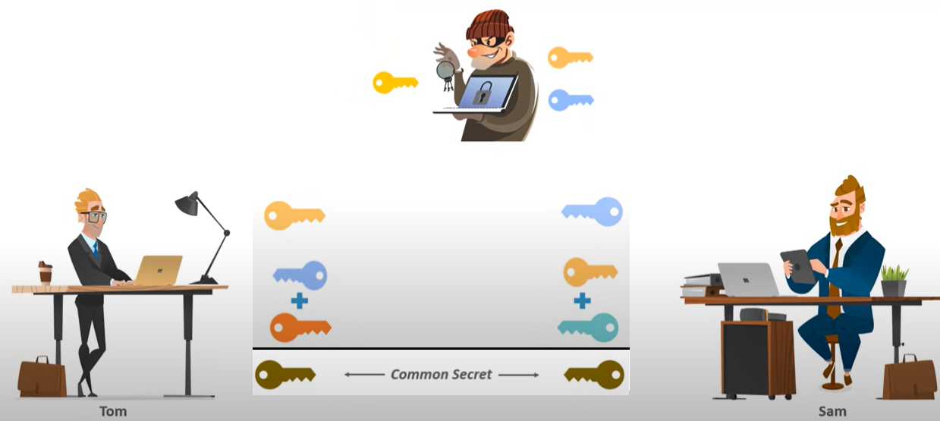
Key Exchange Protocols

Slide 36
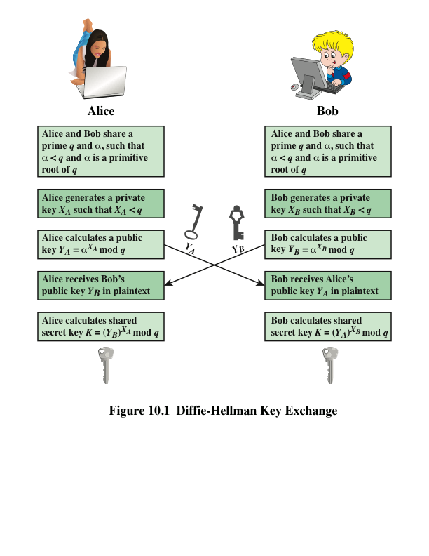
Notes:
Figure 10.1 summarizes the Diffie-Hellman key exchange algorithm. For this
scheme, there are two publicly known numbers: a prime number q and an integer a
that is a primitive root of q .

Slide 37
Diffie Hellman Example
Lets choose a prime number q = 353, and α=3, a primitive root of q (α and q are known to both A and B and anyone else, including attacker).
A and B exchange their keys, YA and YB. This can be done publicly (that is, the attacker can see the keys).
A selects XA = 97 YA = α^{XA} mod q YA= 3⁹⁷ mod 353 =40 | B selects XB = 233 YB = α^{XB} mod q 3²³³ mod 353 = 248
A calculates: YB ^{XA} mod q = 248⁹⁷ mod 353 = 160 | B calculates: YA ^{XB} mod q = 40²³³ mod 353 = 160
Notes:
A primitive root mod n is an integer g such that every integer relatively prime to n is congruent to a power of g mod n. That is, the integer g is a primitive root (mod n) if for every number a relatively prime to n there is an integer z such that.

Slide 38
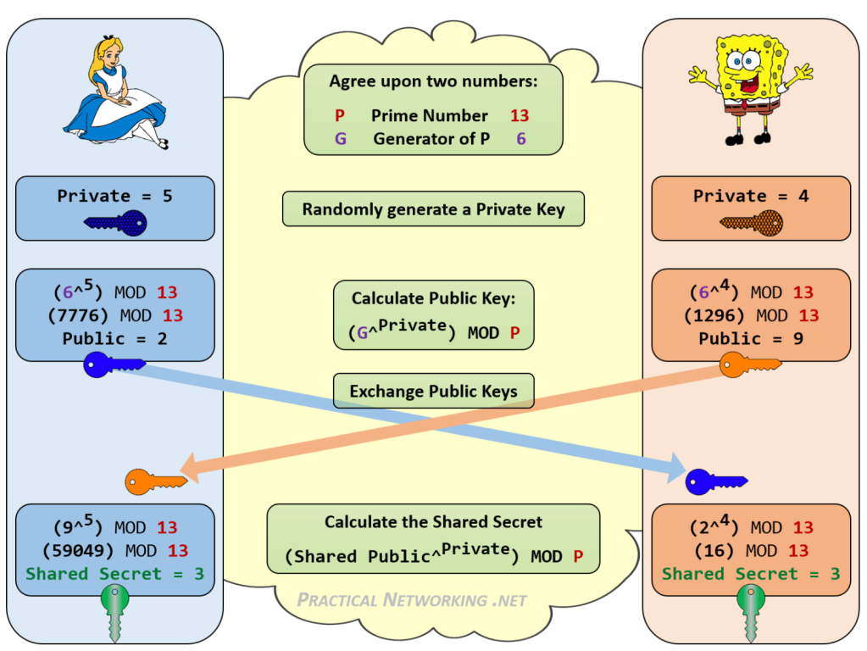
a
b
Gª mod p
G^{b} mod p
(G^{b} mod p)ª
G^{ab} mod p
(Gª mod p)^{b}
Notes:
A primitive root mod n is an integer g such that every integer relatively prime to n is congruent to a power of g mod n. That is, the integer g is a primitive root (mod n) if for every number a relatively prime to n there is an integer z such that.

Slide 39
Attacks
Man-in-the-Middle-Attack. To counter this attack, authentication of the keys is needed.
A brute force attack on the private keys. To counter this attack, large values of XA and XB are used. For large values of XA and XB, calculating the inverse of the exponentiation (that is the discrete logarithm) is very difficult! Hence, hard to break.

Slide 40
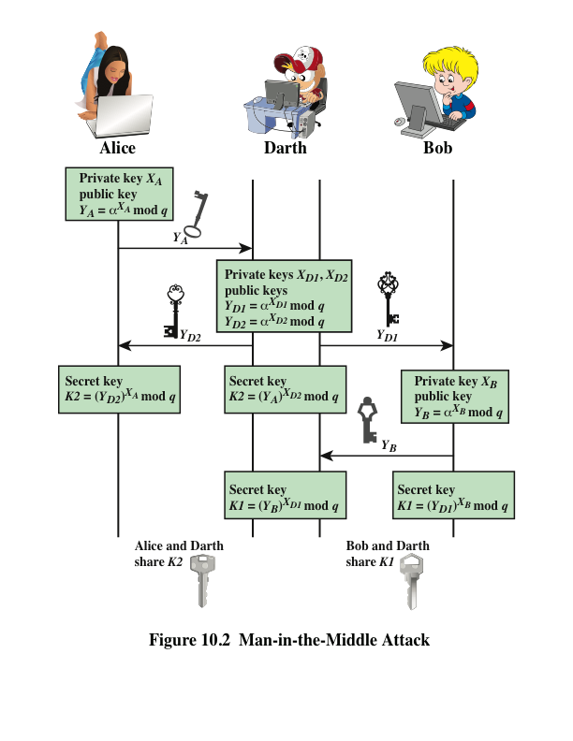
Notes:
The protocol depicted in Figure 10.1 is insecure against a man-in-the-middle attack.
Suppose Alice and Bob wish to exchange keys, and Darth is the adversary. The
attack proceeds as follows (Figure 10.2).
Darth prepares for the attack by generating two random private keys X_{D1} and X_{D2} and then computing the corresponding public keys Y_{D1} and Y_{D2}
Alice transmits Y_{A} to Bob.
Darth intercepts Y_{A} and transmits Y_{D1} to Bob. Darth also calculates K2 = (Y_{A} )^ X_{D2} mod q
Bob receives Y_{D1} and calculates K1=(Y_{D1} )^ X_{B} mod q
Bob transmits Y_{B} to Alice.
Darth intercepts Y_{B} and transmits Y_{D2} to Alice. Darth calculates K1=(Y_{B} )^ X_{D1} mod q
Alice receives Y_{D2} and calculates K2=(Y_{D2} )^ X_{A} mod q .
At this point, Bob and Alice think that they share a secret key, but instead Bob and Darth share secret key K1 and Alice and Darth share secret key K2. All future communication between Bob and Alice is compromised in the following way:
Alice sends an encrypted message M: E(K2, M).
Darth intercepts the encrypted message and decrypts it, to recover M.
Darth sends Bob E(K1, M) or E(K1, M'), where M' is any message. In the first case, Darth simply wants to eavesdrop on the communication without altering it. In the second case, Darth wants to modify the message going to Bob.
The key exchange protocol is vulnerable to such an attack because it does not authenticate the participants. This vulnerability can be overcome with the use of digital signatures and public- key certificates.

Slide 41
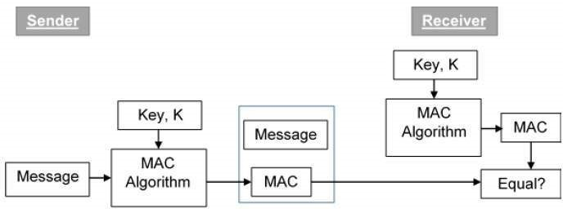
Message Authentication Codes
Message authentication codes (MACs) are a security measure commonly attached to electronic financial transactions.
MAC steps:
The sender uses some publicly known MAC algorithm, inputs the message and the symmetric key K and produces a MAC value.
The sender forwards the message along with the MAC.
The receiver verifies MAC by calculating the MAC with the same algorithm, message, and key.
Notes:
Encryption protects against passive attack (eavesdropping). A different requirement
is to protect against active attack (falsification of data and transactions).
Protection against such attacks is known as message authentication.
A message, file, document, or other collection of data is said to be authentic
when it is genuine and comes from its alleged source. Message authentication is a
procedure that allows communicating parties to verify that received messages are
authentic. The two important aspects are to verify that the contents of the message
have not been altered and that the source is authentic. We may also wish to
verify a message’s timeliness (it has not been artificially delayed and replayed) and
sequence relative to other messages flowing between two parties. All of these concerns
come under the category of data integrity as described in Chapter 1.

Slide 42
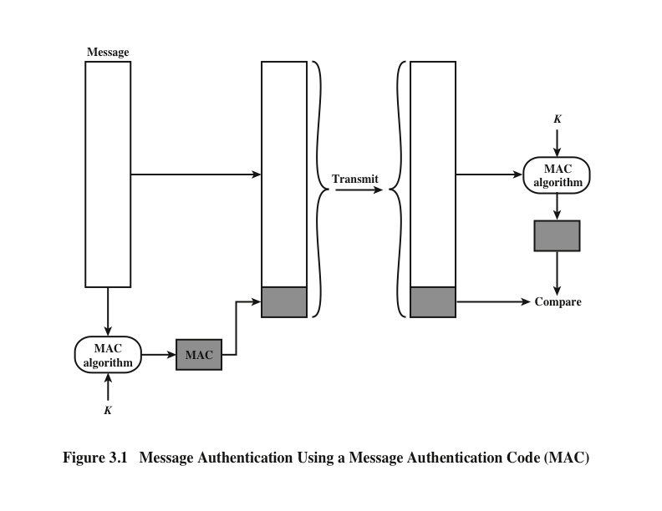
Notes:
One authentication technique involves the use of a secret key to generate a small block of data, known as a message authentication code (MAC) , that is appended to the message.
This technique assumes that two communicating parties, say A and B, share a common secret key K_{AB}.
When A has a message to send to B, it calculates the message authentication code as a
function of the message and the key: MAC_{M} = F(K_{AB} , M ). The message plus code
are transmitted to the intended recipient. The recipient performs the same calculation
on the received message, using the same secret key, to generate a new message
authentication code. The received code is compared to the calculated code
(Figure 3.1).
If we assume that only the receiver and the sender know the identity
of the secret key, and if the received code matches the calculated code, then the following
statements apply:
1. The receiver is assured that the message has not been altered. If an attacker
alters the message but does not alter the code, then the receiver’s calculation
of the code will differ from the received code. Because the attacker is assumed
not to know the secret key, the attacker cannot alter the code to correspond to
the alterations in the message.
2. The receiver is assured that the message is from the alleged sender. Because
no one else knows the secret key, no one else could prepare a message with a
proper code.
3. If the message includes a sequence number (such as is used with HDLC and
TCP), then the receiver can be assured of the proper sequence, because an
attacker cannot successfully alter the sequence number.
A number of algorithms could be used to generate the code. The NIST specification,
FIPS PUB 113, recommends the use of DES. DES is used to generate an
encrypted version of the message, and the last number of bits of ciphertext are used
as the code. A 16- or 32-bit code is typical.
The process just described is similar to encryption. One difference is that the
authentication algorithm need not be reversible, as it must for decryption. Because
of the mathematical properties of the authentication function, it is less vulnerable to
being broken than encryption.

Slide 43
Hash Functions
A cryptographic hash function is a mathematical function used in cryptography. Typical hash functions take inputs of variable lengths (M) to return a unique outputs of a fixed length H(M) .
To authenticate a message, the message hash is sent with the message.
Similar to MAC, hash function also compresses a long input into a fixed length output. The major difference between hash and MAC is that MAC uses secret key during the compression, while hash function does not take a secret key as input

Slide 44
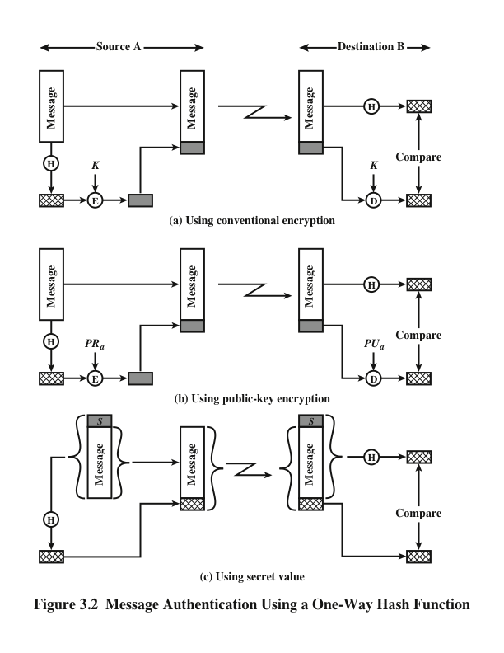
Notes:
Figure 3.2 illustrates three ways in which the message can be authenticated.
The message digest can be encrypted using conventional encryption (part a); if
it is assumed that only the sender and receiver share the encryption key, then
authenticity is assured. The message digest can be encrypted using public-key
encryption (part b); this is explained in Section 3.5. The public-key approach
has two advantages: (1) It provides a digital signature as well as message
authentication. (2) It does not require the distribution of keys to communicating
parties.
These two approaches also have an advantage over approaches that encrypt
the entire message in that less computation is required. Nevertheless, there has
been interest in developing a technique that avoids encryption altogether.
Figure 3.2c shows a technique that uses a hash function but no encryption for
message authentication.
Because the secret value itself is not sent, it is not possible for an attacker to modify an intercepted message.
As long as the secret value remains secret, it is also not possible for an attacker to generate
a false message.
A variation on the third technique, called HMAC, is the one adopted for IP security (described in Chapter 9);
it also has been specified for SNMPv3
(Chapter 13).

Slide 45
Hash Function Properties
To be useful for message authentication, a hash function H must have the following properties:
H can be applied to a block of data of any size.
1.
H produces a fixed-length output.
2.
H(x) is easy to compute for any given x, making both hardware and software implementations practical.
3.
For any given code h, it is computationally infeasible to find x such that H(x) = h. A hash function with this property is referred to as one-way or preimage resistant.
4.
It is computationally infeasible to find any pair (x, y) such that H(x) = H(y).
A hash function with this property is referred to as collision resistant. This is sometimes referred to as strong collision resistant.
5.
Notes:
The purpose of a hash function is to produce a “fingerprint” of a file, message, or
other block of data. To be useful for message authentication, a hash function H
must have the following properties:
1. H can be applied to a block of data of any size.
2. H produces a fixed-length output.
3. H(x ) is relatively easy to compute for any given x , making both hardware and
software implementations practical.
4. For any given code h , it is computationally infeasible to find x such that
H(x ) = h. A hash function with this property is referred to as one-way or
preimage resistant .
5. For any given block x, it is computationally infeasible to find y x with
H(y) = H(x). A hash function with this property is referred to as second preimage
resistant. This is sometimes referred to as weak collision resistant.
6. It is computationally infeasible to find any pair (x, y) such that H(x) = H(y).
A hash function with this property is referred to as collision resistant. This is
sometimes referred to as strong collision resistant.
A hash function that satisfies the first five properties in the preceding list is
referred to as a weak hash function. If the sixth property is also satisfied, then it is
referred to as a strong hash function. The sixth property, collision resistant, protects
against a sophisticated class of attack known as the birthday attack.

Slide 46
Hash Function Properties
The hash function must be:
Deterministic: a given input will always produce the same output.
Irreversible (one way): it is impossible to determine the input that produced a given output.
With Fixed-size output: It produces a fixed-size output regardless of the input size. This property is essential because it enables efficient storage and retrieval of data.
Sensitive to input changes: A slight change in the input to a hash function should produce a significant difference in the output.
Collision resistant: A good hash function should be resistant to collisions, which occur when different inputs produce the same output.
Efficient: A hash function should be fast as it is for real-time applications where speed is critical.
Notes:
These functions possess several important properties that make them useful in various applications. These properties include:
Determinism: A hash function is deterministic, meaning a given input will always produce the same output.
Uniformity: A good hash function should produce uniformly distributed outputs. This means that the probability of any given work should be equal. This property is essential because it helps to avoid collisions, where different inputs produce the same result.
Non-reversibility: A hash function is non-reversible, meaning it is impossible to determine the input that produced a given output. This property is essential because it helps to ensure data security and confidentiality.
Fixed-size output: It produces a fixed-size output regardless of the input size. This property is essential because it enables efficient storage and retrieval of data.
Sensitivity to input changes: A slight change in the input to a hash function should produce a significant difference in the output. This property is essential because it helps to ensure data integrity, as even minor changes in the input will result in a different production.
Collision resistance: A good hash function should be resistant to collisions, which occur when different inputs produce the same output. Collision resistance is significant because it helps ensure data accuracy and reliability.
Speed: A hash function should be fast and efficient, as it is for real-time applications where speed is critical.

Slide 47

Security of Hash Functions
There are two approaches to attacking a secure hash function:
Cryptanalysis
Involves exploiting logical weaknesses in the algorithm
Brute-force attack
The strength of a hash function against this attack depends on the length of the hash code produced by the algorithm
Notes:
As with symmetric encryption, there are two approaches to attacking a secure hash
function: cryptanalysis and brute-force attack. As with symmetric encryption algorithms,
cryptanalysis of a hash function involves exploiting logical weaknesses in the
algorithm.
The strength of a hash function against brute-force attacks depends solely on
the length of the hash code produced by the algorithm.
If collision resistance is required (and this is desirable for a general-purpose secure hash code),
then the value 2^{n/2} determines the strength of the hash code against brute-force attacks. Van Oorschot and Wiener [VANO94] presented a
design for a $10 million collision search machine for MD5, which has a 128-bit
hash length, that could find a collision in 24 days. Thus, a 128-bit code may be
viewed as inadequate. The next step up, if a hash code is treated as a sequence
of 32 bits, is a 160-bit hash length. With a hash length of 160 bits, the same
search machine would require over four thousand years to find a collision. With
today’s technology, the time would be much shorter, so that 160 bits now
appears suspect.

Slide 48
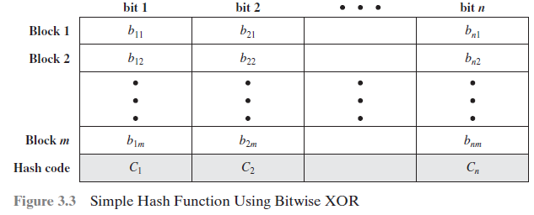
Notes:
All hash functions operate using the following general principles. The input (message, file, etc.) is viewed as a sequence of n -bit blocks.
The input is processed one block at a time in an iterative fashion to produce an n -bit hash function.
One of the simplest hash functions is the bit-by-bit exclusive-OR (XOR) of every block.
Figure 3.3 illustrates this operation; it produces a simple parity for each bit position and is known as a longitudinal redundancy check.

Slide 49
SHA Hash function
Secure Hash Algorithm (SHA) was developed by NIST and published as a federal information processing standard (FIPS 180) in 1993
Was revised in 1995 as SHA-1 and published as FIPS 180-1
The actual standards document is entitled “Secure Hash Standard”. SHA is based on the hash function MD4
Produces 160-bit hash values
In 2005 NIST announced the intention to phase out approval of SHA-1 and move to a reliance on SHA-2 by 2010
Notes:
In recent years, the most widely used hash function has been the Secure Hash
Algorithm (SHA). Indeed, because virtually every other widely used hash function
had been found to have substantial cryptanalytic weaknesses, SHA was more or
less the last remaining standardized hash algorithm by 2005. SHA was developed
by the National Institute of Standards and Technology (NIST) and published as a
federal information processing standard (FIPS 180) in 1993. When weaknesses were
discovered in SHA (now known as SHA-0), a revised version was issued as FIPS
180-1 in 1995 and is referred to as SHA-1 . The actual standards document is entitled
“Secure Hash Standard.” SHA is based on the hash function MD4, and its design
closely models MD4.
SHA-1 produces a hash value of 160 bits.
In 2005, NIST announced the intention to phase out approval of SHA-1 and
move to a reliance on SHA-2 by 2010.

Slide 50
Common Hash functions
MD5: Simple algorithm, produces 128bit hash.
SHA-0: Original algorithm 1993, produces 160bit hash
SHA-1: Revised in 1995, produces 160bit hash
SHA-256: Revised in 2001, produces 256bit hash
SHA-512: Revised in 2001, produces 512bit hash
HMAC (Hash-based MAC): hash is sent with the message.
Notes:
In recent years, the most widely used hash function has been the Secure Hash
Algorithm (SHA). Indeed, because virtually every other widely used hash function
had been found to have substantial cryptanalytic weaknesses, SHA was more or
less the last remaining standardized hash algorithm by 2005. SHA was developed
by the National Institute of Standards and Technology (NIST) and published as a
federal information processing standard (FIPS 180) in 1993. When weaknesses were
discovered in SHA (now known as SHA-0), a revised version was issued as FIPS
180-1 in 1995 and is referred to as SHA-1 . The actual standards document is entitled
“Secure Hash Standard.” SHA is based on the hash function MD4, and its design
closely models MD4.
SHA-1 produces a hash value of 160 bits.
In 2005, NIST announced the intention to phase out approval of SHA-1 and
move to a reliance on SHA-2 by 2010.

Slide 51
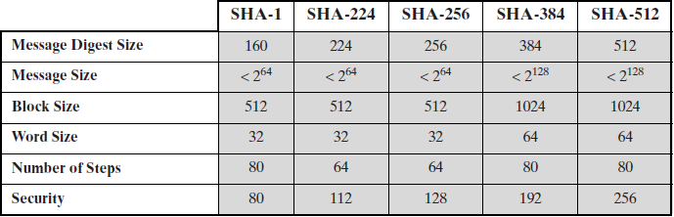
Table 3.1 Comparison of SHA Parameters
Note: All sizes are measured in bits.
Notes:
In 2002, NIST produced a revised
version of the standard, FIPS 180-2, that defined three new versions of SHA with
hash value lengths of 256, 384, and 512 bits known as SHA-256, SHA-384, and
SHA-512, respectively. Collectively, these hash algorithms are known as SHA-2 .
These new versions have the same underlying structure and use the same types of
modular arithmetic and logical binary operations as SHA-1. A revised document
was issued as FIP PUB 180-3 in 2008, which added a 224-bit version (Table 3.1).
SHA-1 and SHA-2 are also specified in RFC 6234, which essentially duplicates the
material in FIPS 180-3 but adds a C code implementation.

Slide 52
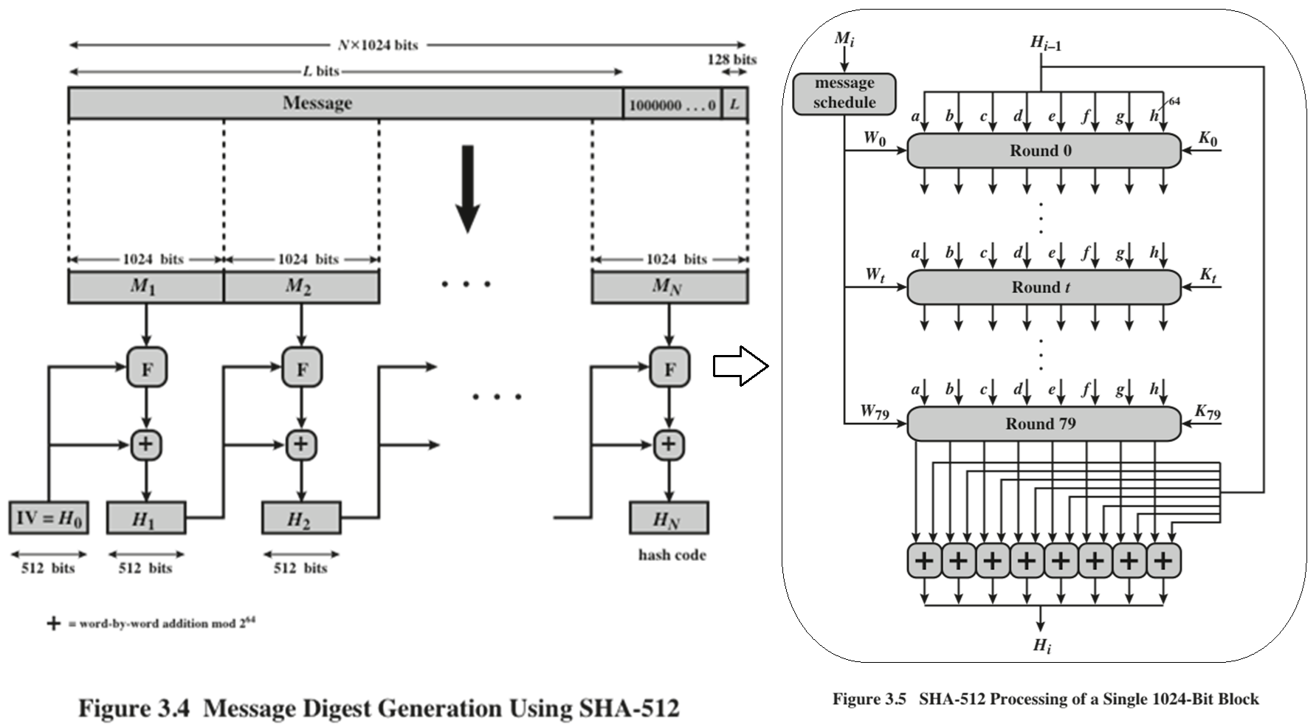
Notes:
The algorithm takes as input a message with a maximum length of less than
2¹²⁸ bits and produces as output a 512-bit message digest. The input is processed in
1024-bit blocks. Figure 3.4 depicts the overall processing of a message to produce a
digest.
At the end of the original message, we add 1 then 0’s until reach the length (896 mod 1024),
leaving 24 bits to represent the original message length. Each block is divided into 16 words with 64 bits,
Then, we start a loop to compute new words from 16 to 79 words.
Fig 3.5: in each round, we have k (round constant) and 8 inputs, each of 64 bits→ 512 bits.

Slide 53
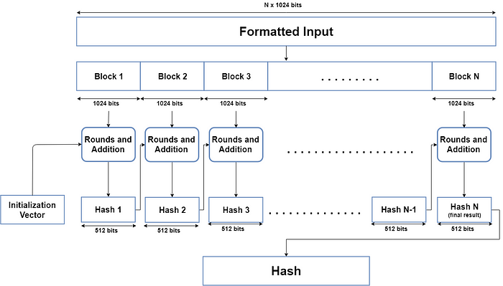
Notes:
The algorithm takes as input a message with a maximum length of less than
2¹²⁸ bits and produces as output a 512-bit message digest. The input is processed in
1024-bit blocks. Figure 3.4 depicts the overall processing of a message to produce a
digest.

Slide 54
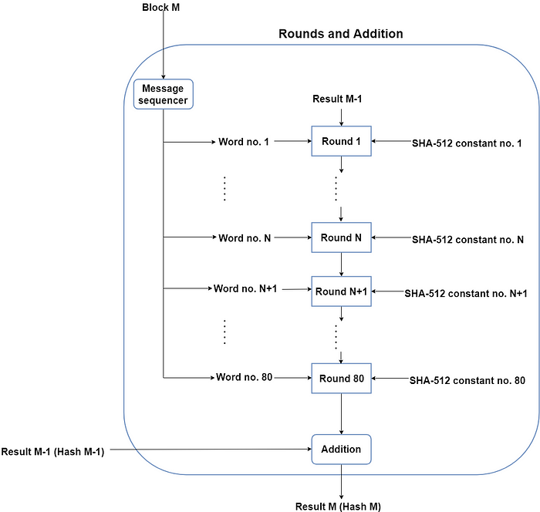
Notes:
The algorithm takes as input a message with a maximum length of less than
2¹²⁸ bits and produces as output a 512-bit message digest. The input is processed in
1024-bit blocks. Figure 3.4 depicts the overall processing of a message to produce a
digest.

Slide 55

SHA-3
2. SHA-3 must preserve the online nature of SHA-2. That is, the algorithm must process comparatively small blocks (512 or 1024 bits) at a time instead of requiring that the entire message be buffered in memory before processing it.
1. It must be possible to replace SHA-2 with SHA-3 in any application by a simple drop-in substitution. Therefore, SHA-3 must support hash value lengths of 224, 256, 384, and 512 bits.
Basic requirements that must be satisfied by any candidate for
SHA-3
Notes:
SHA-2, particularly the 512-bit version, would appear to provide unassailable security.
However, SHA-2 shares the same structure and mathematical operations
as its predecessors, and this is a cause for concern. Because it would take years to find a
suitable replacement for SHA-2, should it become vulnerable, NIST announced in
2007 a competition to produce the next-generation NIST hash function, which is to
be called SHA-3. Following are the basic requirements that must be satisfied by any
candidate for SHA-3:
1. It must be possible to replace SHA-2 with SHA-3 in any application by a simple
drop-in substitution. Therefore, SHA-3 must support hash value lengths of
224, 256, 384, and 512 bits.
2. SHA-3 must preserve the online nature of SHA-2. That is, the algorithm must
process comparatively small blocks (512 or 1024 bits) at a time instead of
requiring that the entire message be buffered in memory before processing it.
In 2012, NIST selected a winning submission and formally published SHA-3.
A detailed presentation of SHA-3 is provided in Chapter 15.

Slide 56
HMAC
There has been an increased interest in developing a MAC derived from a cryptographic hash code, such as SHA-1
Cryptographic hash functions generally execute faster in software than conventional encryption algorithms such as DES
Library code for cryptographic hash functions is widely available
A hash function such as SHA-1 was not designed for use as a MAC and cannot be used directly for that purpose because it does not rely on a secret key
There have been a number of proposals for the incorporation of a secret key into an existing hash algorithm. The approach that has received the most support is HMAC
HMAC
Has been issued as RFC 2104
Has been chosen as the mandatory-to-implement MAC for IP Security
Is used in other Internet protocols, such as Transport Layer Security (TLS) and Secure Electronic Transaction (SET)
Notes:
In recent years, there has been increased interest in developing a MAC derived
from a cryptographic hash code, such as SHA-1. The motivations for this interest
are as follows:
• Cryptographic hash functions generally execute faster in software than conventional
encryption algorithms such as DES.
• Library code for cryptographic hash functions is widely available.
A hash function such as SHA-1 was not designed for use as a MAC and cannot
be used directly for that purpose because it does not rely on a secret key. There have
been a number of proposals for the incorporation of a secret key into an existing hash
algorithm. The approach that has received the most support is HMAC [BELL96a,
BELL96b]. HMAC has been issued as RFC 2104, has been chosen as the mandatory-to-
implement MAC for IP Security, and is used in other Internet protocols, such as
Transport Layer Security (TLS) and Secure Electronic Transaction (SET).

Slide 57
HMAC Design Objectives
To use, without modifications, available hash functions --- in particular, hash functions that perform well in software, and for which code is freely and widely available
To allow for easy replace-ability of the embedded hash function in case faster or more secure hash functions are found or required
To preserve the original performance of the hash function without a significant degradation
To use and handle keys in a simple way
To have a well understood cryptographic analysis of the strength of the authentication mechanism based on reasonable assumptions on the embedded hash function
Notes:
RFC 2104 lists the following design objectives for
HMAC.
• To use, without modifications, available hash functions. In particular, hash functions that perform well in software, and for which code is freely and
widely available
• To allow for easy replaceability of the embedded hash function in case faster or more secure hash functions are found or required
• To preserve the original performance of the hash function without incurring a
significant degradation
• To use and handle keys in a simple way
• To have a well-understood cryptographic analysis of the strength of the authentication mechanism based on reasonable assumptions on the embedded
hash function
The first two objectives are important to the acceptability of HMAC. HMAC
treats the hash function as a “black box.” This has two benefits. First, an existing
implementation of a hash function can be used as a module in implementing
HMAC. In this way, the bulk of the HMAC code is prepackaged and ready to use
without modification. Second, if it is ever desired to replace a given hash function
in an HMAC implementation, all that is required is to remove the existing hash
function module and drop in the new module. This could be done if a faster hash
function were desired. More important, if the security of the embedded hash function
were compromised, the security of HMAC could be retained simply by replacing
the embedded hash function with a more secure one
.
The last design objective in the preceding list is, in fact, the main advantage
of HMAC over other proposed hash-based schemes. HMAC can be proven secure
provided that the embedded hash function has some reasonable cryptographic
strengths. We return to this point later in this section, but first we examine the structure
of HMAC.

Slide 58
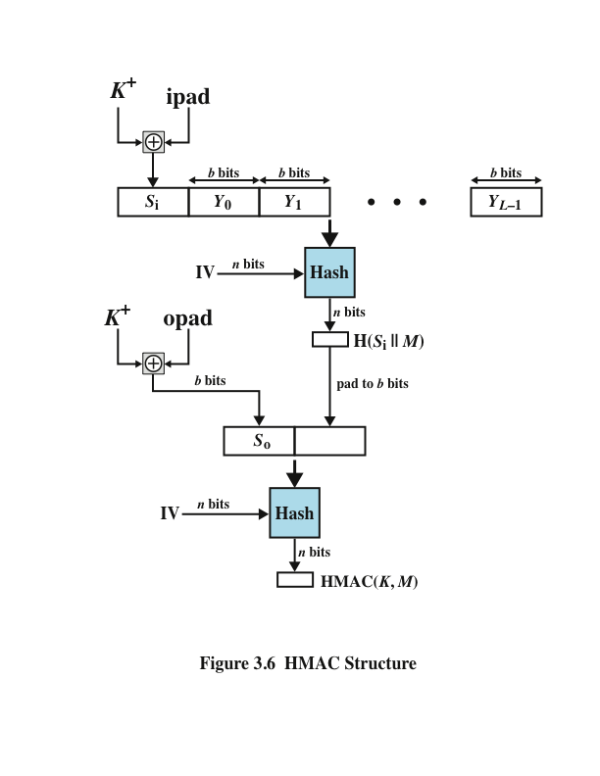
Notes:
Figure 3.6 illustrates the overall operation of HMAC.
b → number of bits in a block
n → length of hash code produced by embedded hash function
K → secret key; if key length is greater than b, the key is input to the hash
function to produce an n-bit key; recommended length is > n
K⁺→ K padded with zeros on the left so that the result is b bits in length
ipad → 00110110 (36 in hexadecimal) repeated b/8 times
opad → 01011100 (5C in hexadecimal) repeated b/8 times
Then HMAC can be expressed as
HMAC(K,M)= H[(K⁺ XOR opad) || H[(K⁺ XOR ipad) || M]]

Slide 59
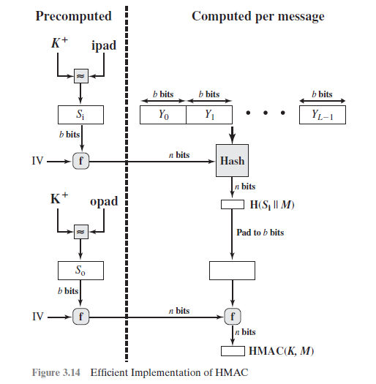

Slide 60
Digital Signature standard (DSS)
DSS is a cryptographic algorithm used to generate digital signatures to authenticate the sender of a digital message.
Originally proposed in 1991 in FIPS PUB 186, and revised in 1993 and again in 1996. DSA works by having two keys: a private key owned by the sender and a public key held by the receiver.
Makes use of the SHA-1 and presents a new digital signature technique, the Digital Signature Algorithm (DSA)
Uses an algorithm that is designed to provide only the digital signature function
Unlike RSA, it cannot be used for encryption or key exchange
Notes:
The National Institute of Standards and Technology (NIST) has published Federal Information Processing Standard publications (FIPS PUB 186),
known as the Digital Signature Standard (DSS) . The DSS makes use of the SHA-1
and presents a new digital signature technique, the Digital Signature Algorithm
(DSA). The DSS was originally proposed in 1991 and revised in 1993 in response to
public feedback concerning the security of the scheme. There was a further minor revision
in 1996. The DSS uses an algorithm that is designed to provide only the digital
signature function. Unlike RSA, it cannot be used for encryption or key exchange.

Slide 61
Digital Signature standard (DSS)
NIST FIPS PUB 186-4 (Digital Signature Standard (DSS)) defines a digital signature as: “the result of a cryptographic transformation of data that provides a mechanism for verifying origin authentication, data integrity, and signatory non-repudiation”
Thus, a digital signature is a data-dependent bit pattern, generated by an agent as a function of a file, message, or other form of data block
FIPS 186-4 specifies the use of one of three digital signature algorithms:
Digital signature algorithm (DSA)
RSA digital signature algorithm
Elliptic curve digital signature algorithm (ECDSA)
Notes:
NIST FIPS PUB 186-4 [Digital Signature Standard (DSS) , July 2013] defines a digital
signature as follows: The result of a cryptographic transformation of data that,
when properly implemented, provides a mechanism for verifying origin authentication,
data integrity, and signatory non-repudiation.
Thus, a digital signature is a data-dependent bit pattern, generated by an agent
as a function of a file, message, or other form of data block. Another agent can access
the data block and its associated signature and verify that (1) the data block has
been signed by the alleged signer and that (2) the data block has not been altered
since the signing. Further, the signer cannot repudiate the signature.
FIPS 186-4 specifies the use of one of three digital signature algorithms:
■ Digital Signature Algorithm (DSA): The original NIST-approved algorithm,
which is based on the difficulty of computing discrete logarithms.
■ RSA Digital Signature Algorithm: Based on the RSA public-key algorithm.
■ Elliptic Curve Digital Signature Algorithm (ECDSA): Based on elliptic curve
cryptography.
In this section, we provide a brief overview of the digital signature process,
then describe the RSA digital signature algorithm.

Slide 62
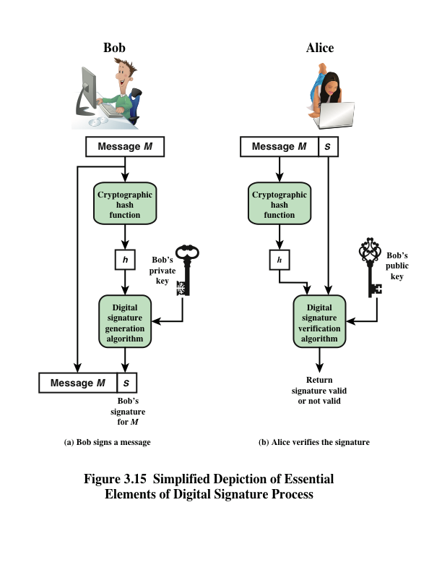
Notes:
Figure 3.15 is a generic model of the process of making and using digital signatures.
All of the digital signature schemes in FIPS 186-4 have this structure. Suppose that
Bob wants to send a message to Alice. Although it is not important that the message
be kept as a secret, he wants Alice to be certain that the message is indeed
from him. For this purpose, Bob uses a secure hash function, such as SHA-512, to
generate a hash value for the message. That hash value, together with Bob’s private
key, serve as input to a digital signature generation algorithm that produces a short
block that functions as a digital signature. Bob sends the message with the signature
attached. When Alice receives the message plus signature, she (1) calculates
a hash value for the message and (2) provides the hash value and Bob’s public key
as inputs to a digital signature verification algorithm. If the algorithm returns the
result that the signature is valid, Alice is assured that the message must have been
signed by Bob. No one else has Bob’s private key and therefore no one else could
have created a signature that could be verified for this message with Bob’s public
key. In addition, it is impossible to alter the message without access to Bob’s private
key, so the message is authenticated both in terms of source and in terms of
data integrity.
It is important to emphasize that the encryption process just described does
not provide confidentiality. That is, the message being sent is safe from alteration,
but not safe from eavesdropping. This is obvious in the case of a signature based
on a portion of the message, because the rest of the message is transmitted in
the clear. Even in the case of complete encryption, there is no protection of confidentiality
because any observer can decrypt the message by using the sender’s
public key.

Slide 63
Elliptic-curve cryptography (ECC)
The majority of public-key cryptography (RSA, D-H) use either integer or polynomial arithmetic with very large numbers/polynomials
Imposes a significant load in storing and processing keys and messages. An alternative is to use elliptic curves
Principal attraction of ECC compared to RSA is that it appears to offer same security with smaller bit sizes, thereby reducing processing overhead

Slide 64
Elliptic-curve cryptography (ECC)
Elliptic-curve cryptography (ECC) is an approach to public-key cryptography based on the algebraic structure of elliptic curves (EC) over finite fields.
Encryption using elliptic curve is done on the principle of solutions to complex equations involving elliptic curves (EC).
EC can be expressed with equations of the form:
y² = x³ + ax + b
where x, y, a, b are all real numbers
Notes:
The vast majority of the products and standards
that use public-key cryptography for encryption and digital signatures use RSA.
The bit length for secure RSA use has increased over recent years, and this has
put a heavier processing load on applications using RSA. This burden has ramifications,
especially for electronic commerce sites that conduct large numbers of secure
transactions. Recently, a competing system has begun to challenge RSA: elliptic
curve cryptography (ECC) . Already, ECC is showing up in standardization efforts,
including the IEEE P1363 Standard for Public-Key Cryptography.
The principal attraction of ECC compared to RSA is that it appears to offer
equal security for a far smaller bit size, thereby reducing processing overhead. On
the other hand, although the theory of ECC has been around for some time, it is
only recently that products have begun to appear and that there has been sustained
cryptanalytic interest in probing for weaknesses. Thus, the confidence level in ECC
is not yet as high as that in RSA.
ECC is fundamentally more difficult to explain than either RSA or Diffie–
Hellman, and a full mathematical description is beyond the scope of this book.
The technique is based on the use of a mathematical construct known as the
elliptic curve.

Slide 65
Elliptic-curve cryptography (ECC)
EC is the set of points that:
satisfy the equation y² = x³ + ax + b (for some constant a and b)
satisfy the the condition: 4a³+27b² mod p ≠ 0
E_{p}(a,b) defined over finite field
y² mod p = (x³+ax+b) mod p
use integers modulo a prime for both variables and coefficients
4a³+27b² mod p ≠ 0
Notes:
See text for detailed rules of addition and relation to zero point O. Can derive an algebraic interpretation of addition, based on computing gradient of tangent and then solving for intersection with curve. This is what is used in practice.

Slide 66
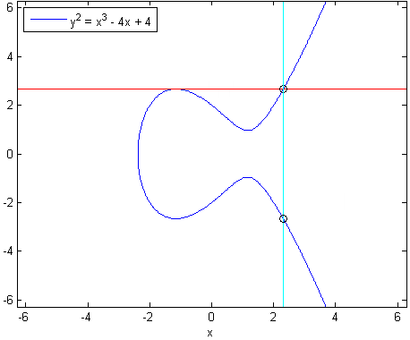
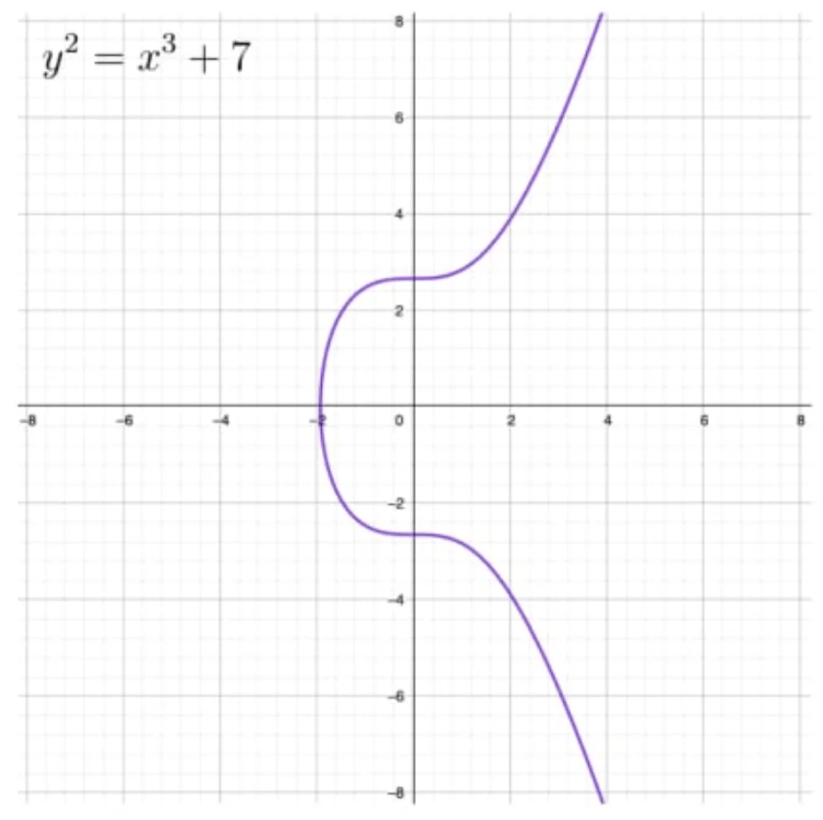
Elliptic-curve cryptography (ECC)
ECC algorithms can use difference EC to prefer the cryptographic speed, strength, and key length.
Notes:
Stallings Fig 10-9b.

Slide 67
Elliptic-curve cryptography (ECC)
Example 1: Does the point (1, 5) fall on the EC consider the EC:
y²=x³ + x + 1 mod 11 ?
Solution: E₁₁(1, 1)→ 4a³+ 27b² mod 11 ≠ 0
4(1)³+ 27(1)² mod 11 ≠ 0 √
y² mod p = (x³+ax+b) mod p
5² mod 11 = (1³+1+1) mod 11
25 mod 11 = 3 mod 11=3 √

Slide 68
Elliptic-curve cryptography (ECC)
Example 1: Does the point (2, 1) fall on the EC consider the EC:
y²=x³ + x + 1 mod 11 ?
Solution: E₁₁(1, 1)→ 4a³+ 27b² mod 11 ≠ 0
4(1)³+ 27(1)² mod 11 ≠ 0 √
y² mod p = (x³+ax+b) mod p
1² mod 11 = (2³+2+1) mod 11
1 mod 11 ≠ 11 mod 11 ×

Slide 69
Elliptic-curve cryptography (ECC)
ECC provides different groups of algorithms based on their use cases, defined over an EC over finite field:
Digital signature→ ECDSA
Encryption/decryption→ EEECC/ ECIES
Key exchange→ ECDH
Notes:
Elliptic curve digital signature algorithm (ECDSA)
El Gamal-based elliptic curve cryptography (EEEC
Elliptic Curve Integrated Encryption Scheme (ECIES)
Elliptic-curve Diffie–Hellman (ECDH)

Slide 70
Elliptic-curve cryptography (ECC)
ECC algorithm steps:
Agree on the EC and establish the public (PU) and private (PR) keys:
Choose a generator point G∈ E_{p}(a,b)
Select PR key n→ 1<n<p-1
Compute PU=n. G
Encode a plaintext message as a point in the curve.
Encrypt the message using the PU:
C=[(K.G),(M+K.PU)]→ (C₁, C₂)
Decrypt the message using the PR
M=C₂-[n. C₁]
Notes:
Agree on the curve E_{p}(a,b)
Establish the public (PU) and private (PR) keys
Exchange public keys

Slide 71
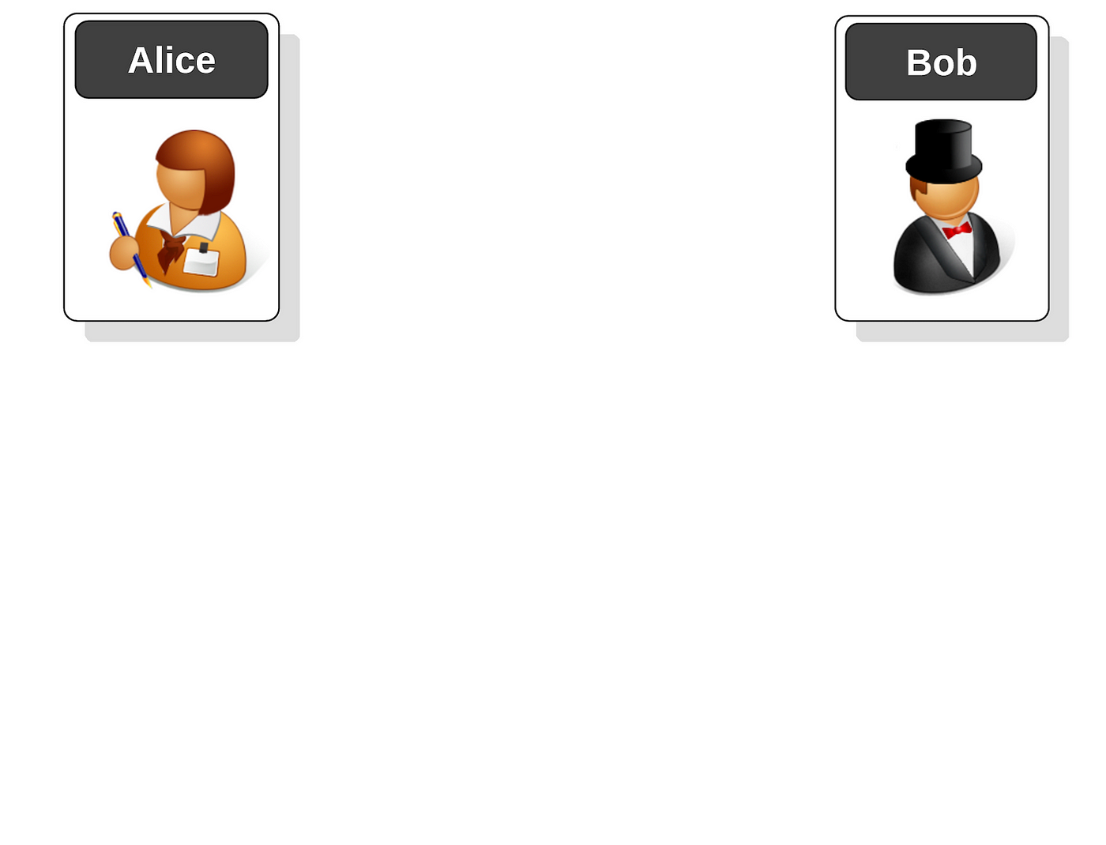
ECC example
E₁₁(1,1) a=1, b=1
(y²=x³+x+1)mod 11
G=(4,5) ∈ E₁₁(1,1)
PR key n=3
PU=n.G=
(4,5)+(4,5)+(4,5)→(1,6)
Encryption using PU_{A}
PU_{A}= (1,6)
M=(0,1) , 1<K<10→2
C=[(K.G),(M+K.PU_{A})]
=[(2. (4,5)), ((0,1)+2.(1,6))]
=[(6,5),((0,1)+(3,8))]
=[(6,5),(0,10)]
Decryption using PR_{A}
M=C₂-[n.C₁]
=(0,10) - 3. (6,5)
=(0,10) - (3,8)
=(0,10) + (3,-8) mod 11
=(0,10) - (3,3)=(0,1)

Slide 72
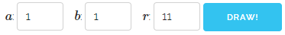
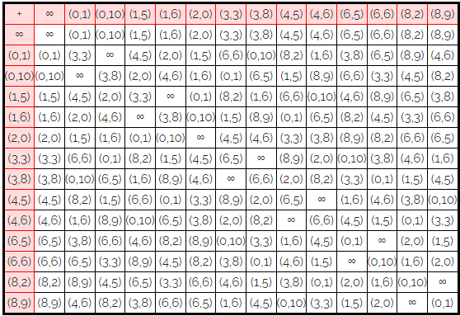
ECC example
Elliptic Curves over Finite Fields: https://graui.de/code/elliptic2/

